Slide 1

Uday Cherukuri, Joey Dyer, and Andrew Wallace

Slide 2
Problem Definition
A lot of information and responsibility in taking care of a dog
Has your dog been fed today? Which food is best? What medication should be taken today? When’s the last time he had a checkup? Etc.
This problem is compounded with multiple dogs
People need a way to keep track of all this information, have it specified to each individual dog, and improve their ability to take care of a dog by learning new, helpful information
Notes:
Joey

Slide 3
The Scope of Man’s Best Friend
Give dogs their own profile!
Each profile has its own reminders, list of activities, and tailored information and advice
Allows owners to see everything about their dog in one place
Provide a database of information on the most popular breeds!
Teach owners about feeding, grooming, medicating, and taking care of their dog
We not only make it easier to take care of your dog, we make you better at it too
Allow dog owners to communicate with others in their area!
“Barks” allow owners to tell others about what’s going on in the dog world around them
Makes the experience even more personal and useful to the customer
Notes:
Joey

Slide 4
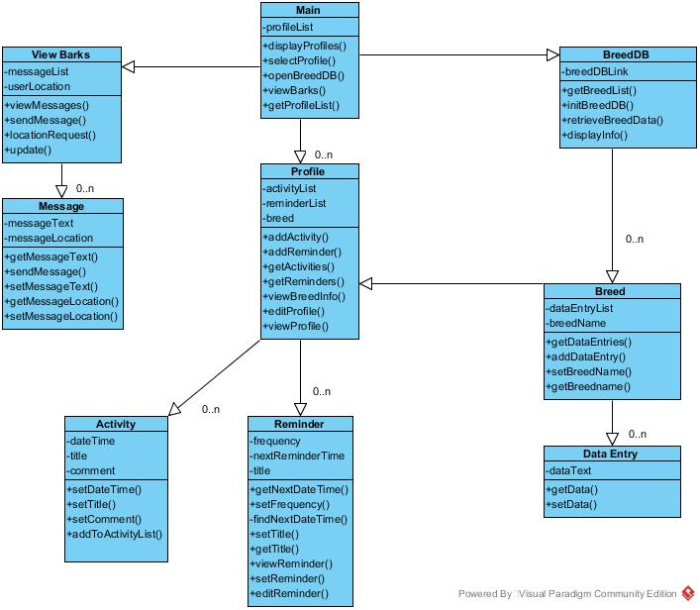
Detailed Class Diagram
Notes:
Andrew

Slide 5
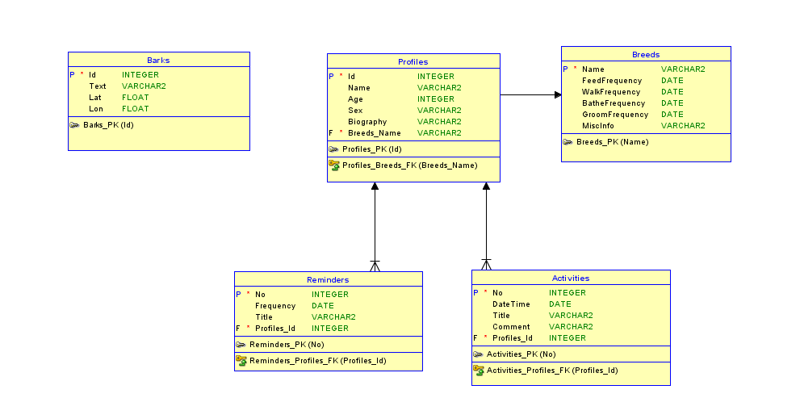
Database Class Diagram
Notes:
Andrew

Slide 6
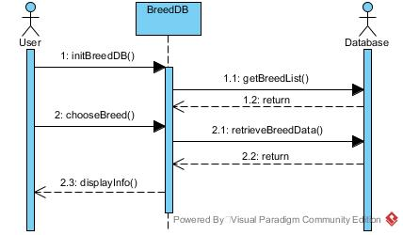
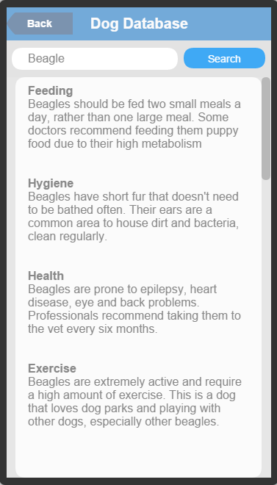
Dog Database
Notes:
Joey

Slide 7
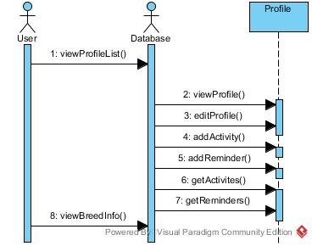
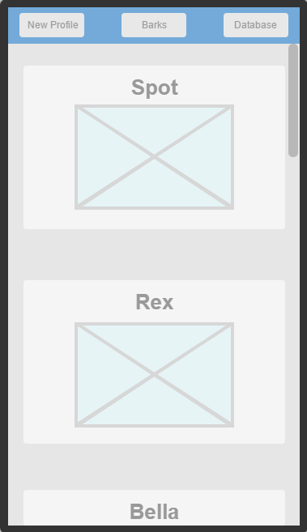
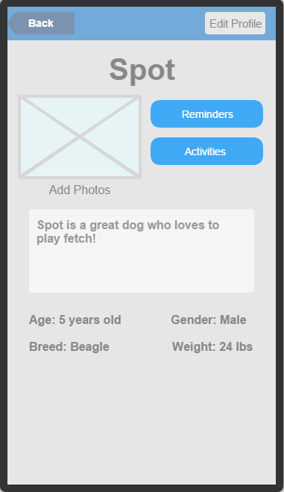
Profiles
Notes:
Uday

Slide 8
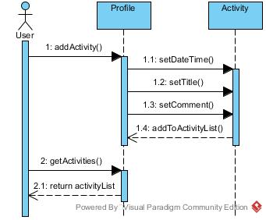
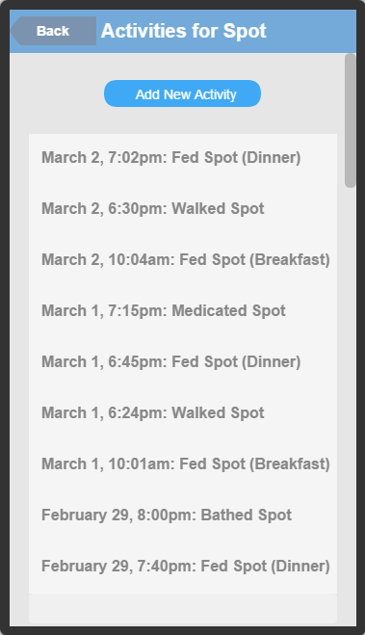
Activity
Notes:
Joey

Slide 9
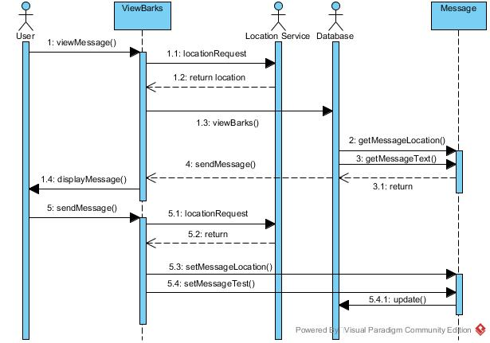
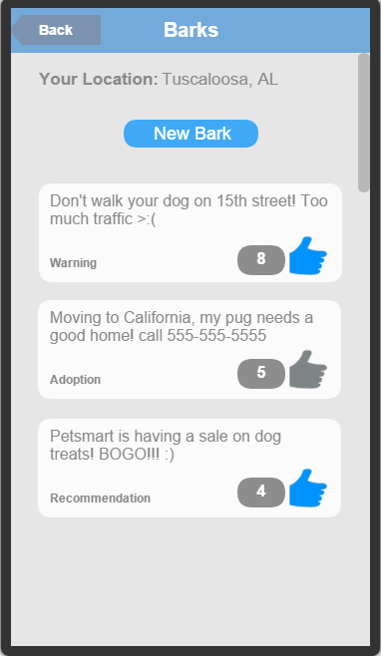
Barks
Notes:
Uday

Slide 10
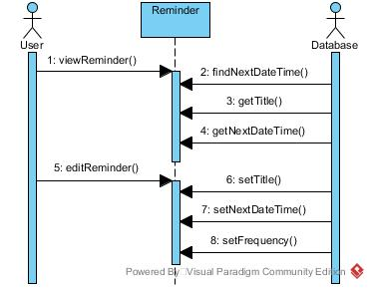
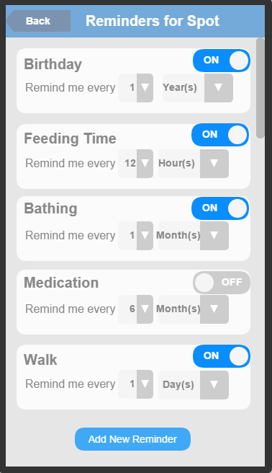
Reminders
Notes:
Uday

Slide 11
Changes Since Requirements
Added descriptions to class and activity diagrams
Moved reminders and activity data into databases
Added Google Location Services as an actor in use case diagram
Notes:
Andrew

Slide 12
Project Summary

Slide 13
Credits
Pet Adoption by Dan Hetteix from The Noun Project

